Slide 1



Home
Projects
Resume
Calorie Tracker
Resume
Projects
About

Slide 2
Home
Projects
Resume
Calorie Tracker
Click below to add a new food item to you daily list
Add

Slide 3
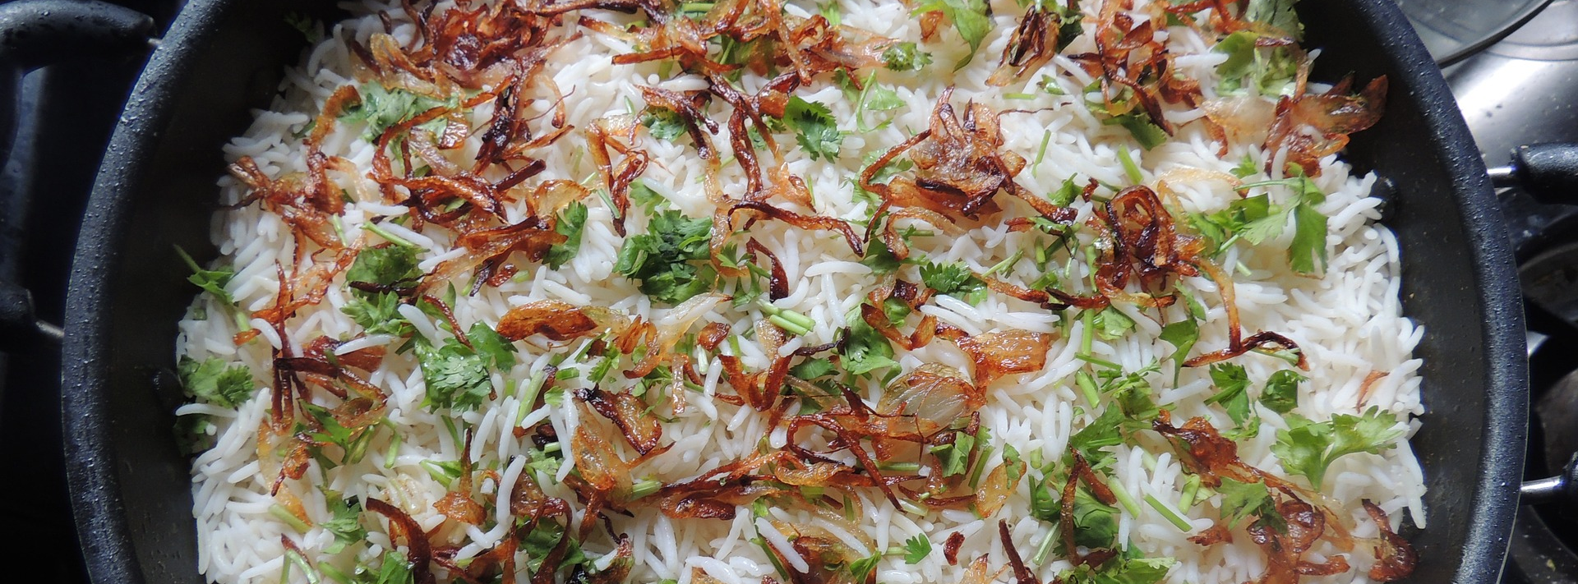
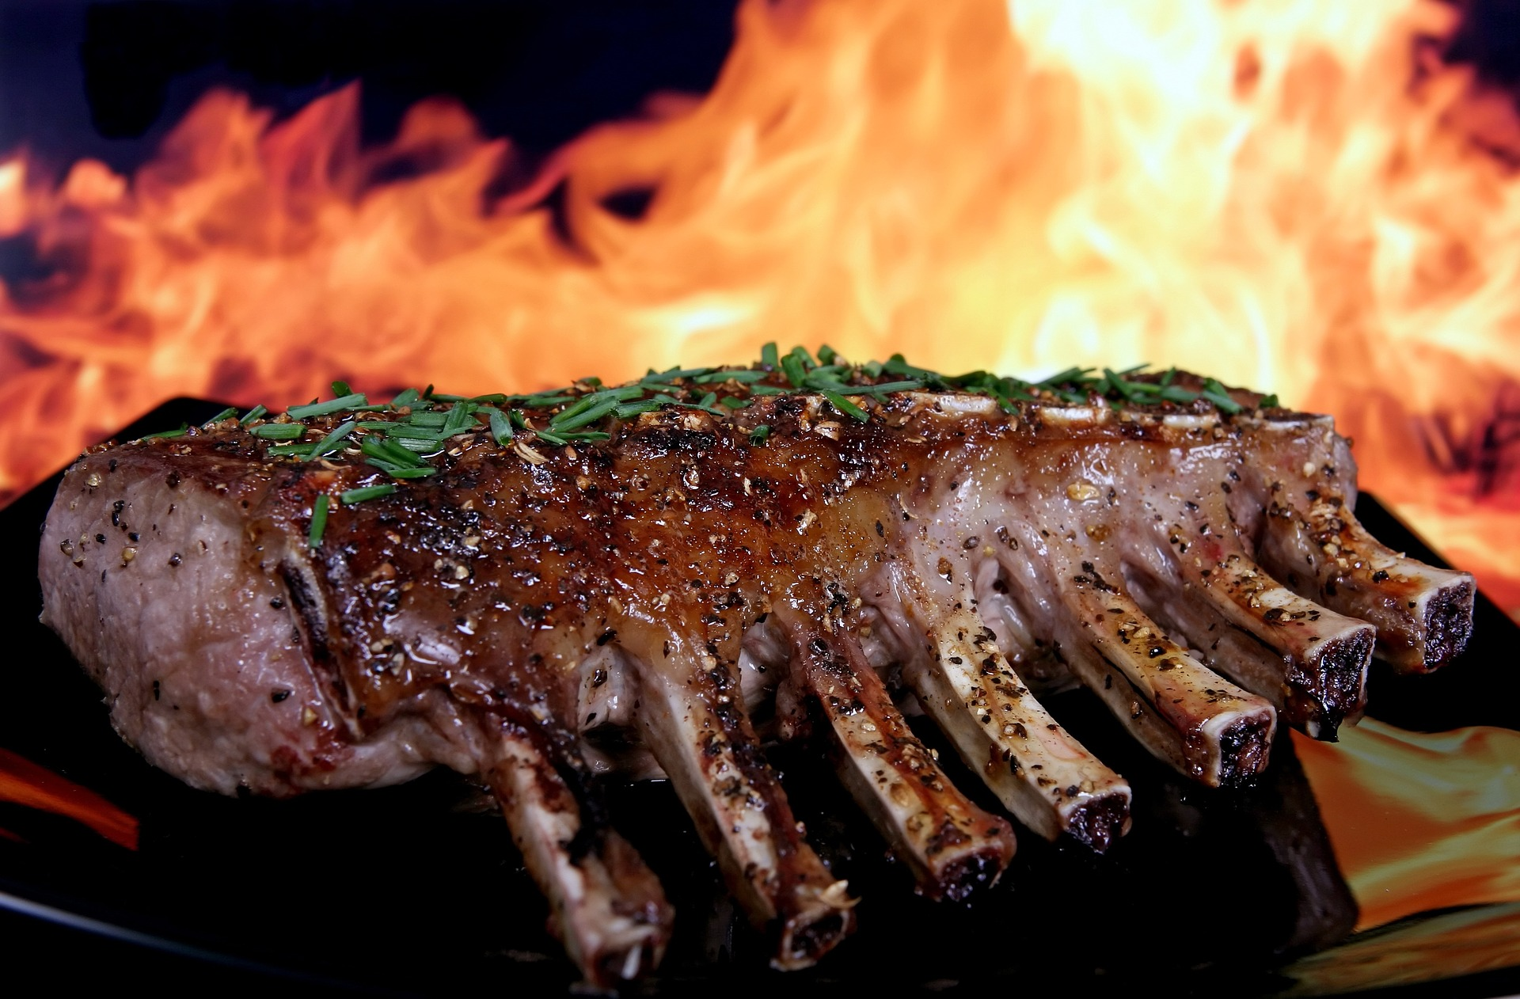

Home
Projects
Resume
Calorie Tracker
Search for day log...
Calorie Tracker
Add Food Item
I Just Went Shopping
1800
calories
Fat 70% 130g 1300 cal
Carbs 5% 22g 130 cal
Protein 25% 111g 450 cal
BreakFAST
400 Calories
Lunch
750 Calories
DINNER
1080 Calories
SNACKS
240 Calories

Slide 4


Home
Projects
Resume
Calorie Tracker
Search for day log...
Calorie Tracker
Add Food Item
I Just Went Shopping

Slide 5

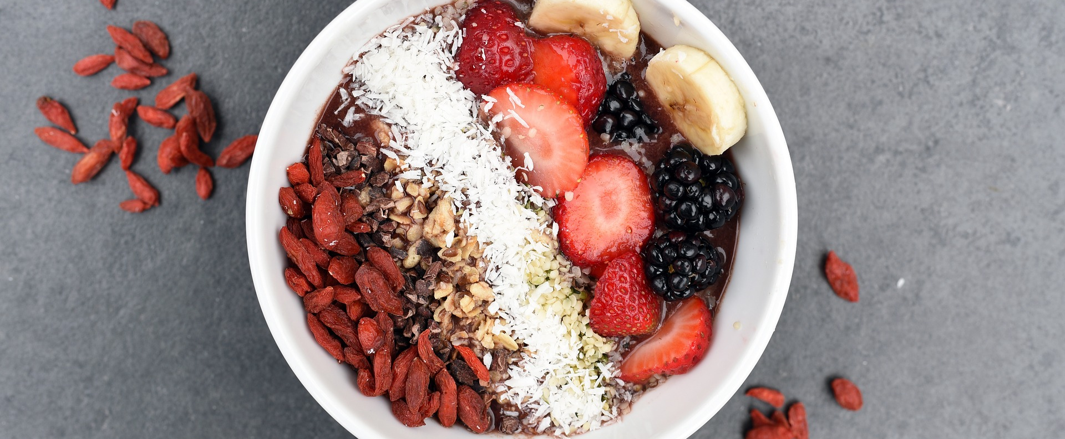
Home
Projects
Resume
Calorie Tracker
Search for day log...
Calorie Tracker
Add Food Item
I Just Went Shopping
FAT
1835
calories
65%
CARBS
265
2100
5%
PROTEIN
30%
BreakFAST
400 Calories
Lunch
755 Calories
DINNER
1209 Calories

